Slide 1
Multi-agent pathfinding in Kiva Systems
Phillip Wong
Daniel Harabor & Pierre Le Bodic
Notes:
Morning / Afternoon ~ Name - Phillip Wong ~ Proj: MAPF ~ Along with 2, Dan, Pierre

Slide 2
Multi-agent pathfinding
For all agents find a path to the goal
Ensure no conflicts
a1 |  |  | a2
g2 |  |  | g1
Notes:
Finding a path for all agent from their location to their goal

Slide 3
Multi-agent pathfinding
a1 |  |  | a2
g2 |  |  | g1

Slide 4
Multi-agent pathfinding
a1 |  | a2
g2 |  |  | g1

Slide 5
Multi-agent pathfinding
a1 | a2
g2 |  |  | g1

Slide 6
Multi-agent pathfinding
a1
g2 | a2 |  | g1

Slide 7
Multi-agent pathfinding
 | a1
a2 |  |  | g1

Slide 8
Multi-agent pathfinding
 |  | a1
a2 |  |  | g1

Slide 9
Multi-agent pathfinding
 |  |  | a1
a2 |  |  | g1

Slide 10
Multi-agent pathfinding
a2 |  |  | a1

Slide 11
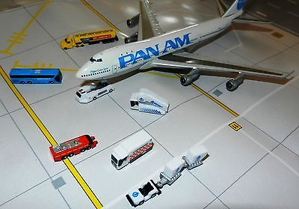
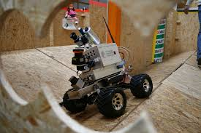
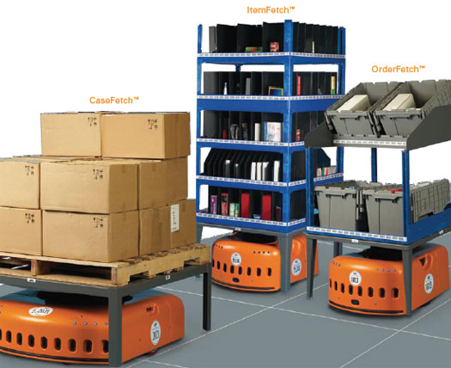
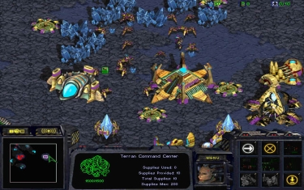
Motivation
Video games
Logistics
Robotics
Warehouse Automation

Slide 12
MAPF in Warehouse Automation
Warehouse Automation
Grid-based map (no diagonal movement)
Objective Functions
Makespan
Sum of cost
Down-time
Cooperative multi-agent pathfinding

Slide 13
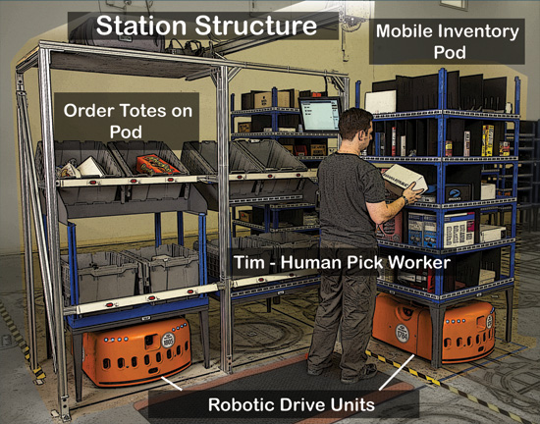
Kiva Systems
AKA Amazon Robotics
Large scale 1000+ robots
Put gif here
Notes:
Order a product from amazon, day arrival => kiva system will * process order * get the required inventory which is located around the warehouse * and packing it into a box

Slide 14
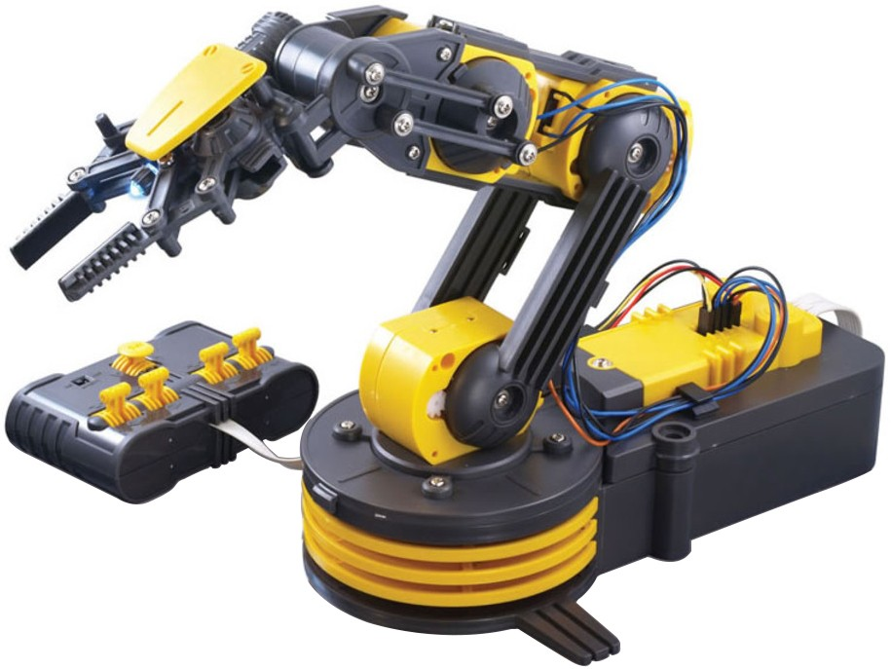

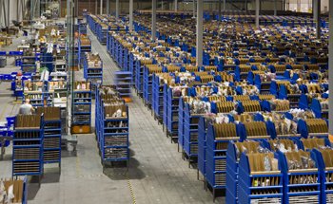
Areas within Kiva Systems
Multiagent pathfinding
Replenishment
Robot allocation
Automated Picking
Warehouse Layout
Notes:
Scheduling problem
* Replenishment of parts and battery
* deciding which picking station is free
* drive allocation
Robotics – automated picking
Optimization
* Warehouse layout
MAPF

Slide 15
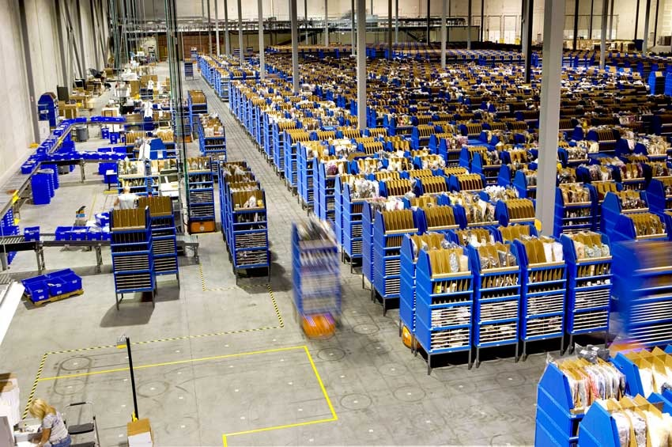
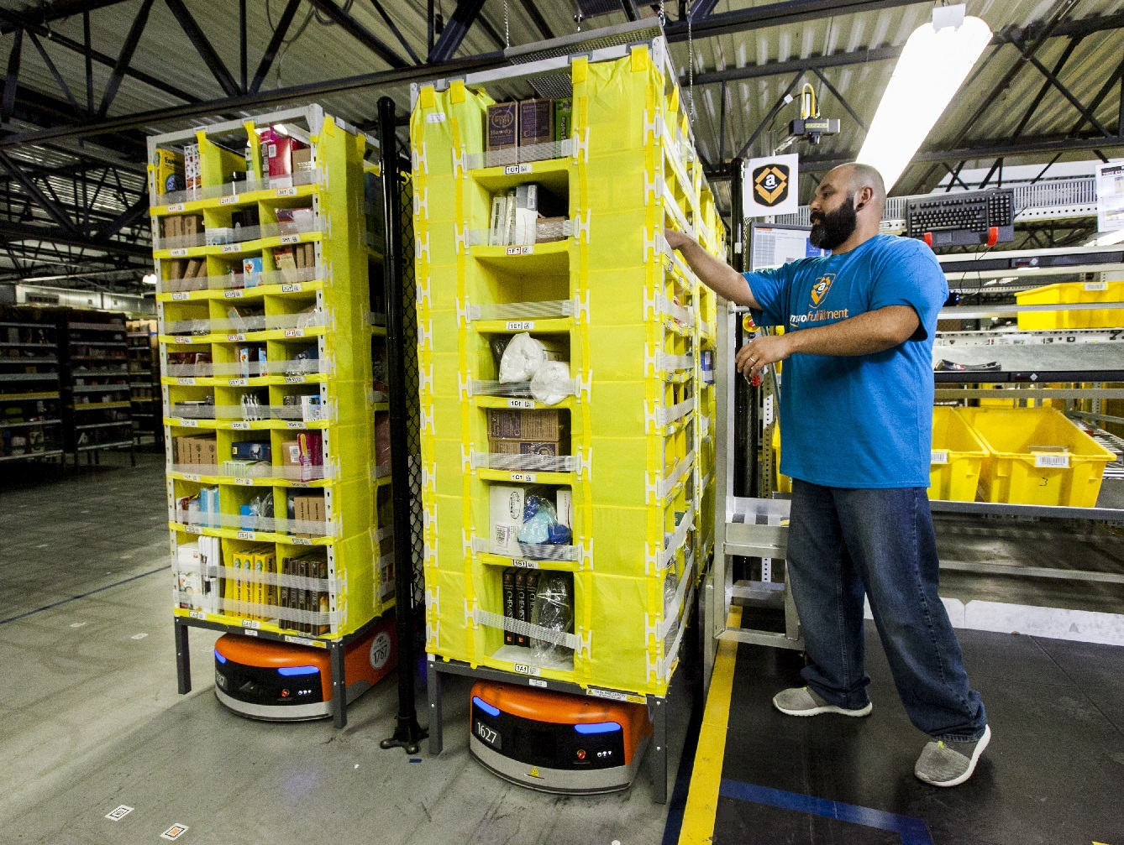
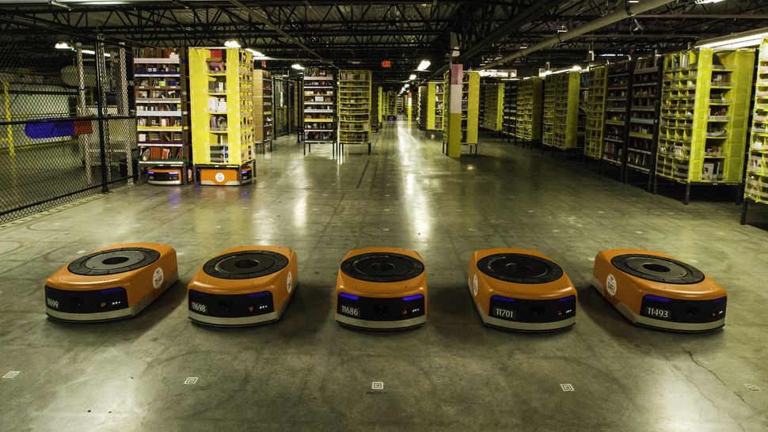
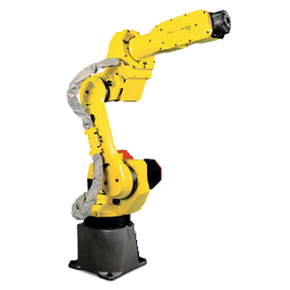
MAPF & part-to-picker system
Assign order
Bring ‘part’
Pick and pack

Slide 16

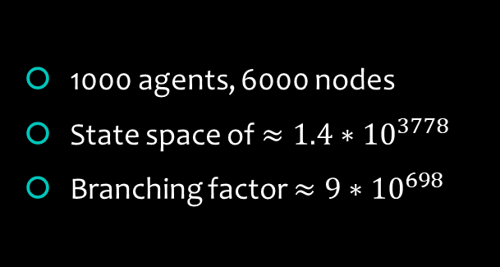
NP-Hard
$k$ agents, $n$ nodes
$n^{k}$ state space
$5^{k}$ branching factor
1000 agents, 6000 nodes
State space of $≈1.4∗{10}^{3778}$
Branching factor ${≈9∗10}^{698}$
15 | 2 | 1 | 12
8 | 5 | 6 | 11
4 | 9 | 10 | 7
3 | 14 | 13
1 | 2 | 3 | 4
5 | 6 | 7 | 8
9 | 10 | 11 | 12
13 | 14 | 15
Notes:
State space: ways to place agents on the grid
5 actions {up down left right wait}

Slide 17
Why optimality?
Better starting point
Bounded suboptimal solution
Optimal = x timesteps
Suboptimal = ?x timesteps
Look at CBS
MIP – Relative gap (% guarantee)

Slide 18
State of the art
Optimal State of the art: 100ish robots
Non-optimal State of the art: 1000ish robots
FAR paper
MAPP
Makespan bad
Conflict Based Search (CBS)
Pic of warehouse sim

Slide 19
Conflict Based Search
PUT COSTS!
Conflict Based Search (CBS)
Path collision <a1, a2, location, time>
Constraint <agent, location, time> not!
Search tree
Exponential tree, branching!
Perform Search
Find Conflicts
Resolve Conflicts
Cons:
Cons: {A1, (2,2), 1}
Cons: {A2, (2,2), 1}
Cons: {A1, (2,2), 1} Cons: {A1, (3,2), 2}
Cons: {A1, (2,2), 1} Cons: {A2, (3,2), 2}

Slide 20
Resolving Conflicts
Perform Search
Find Conflicts
Apply Constraints
Cons:
1
2
3
 |  |  | g2
a2 |  |  | g1
 | a1
1 2 3 4
Notes:
Find a path for each agent
Identify conflicts between paths
Perform search again, reduce the number of conflicts

Slide 21
Resolving Conflicts
Perform Search
Find Conflicts
Apply Constraints
Cons:
1
2
3
 |  |  | g2
a2 |  |  | g1
 | a1
1 2 3 4
Notes:
Find a path for each agent
Identify conflicts between paths
Perform search again, reduce the number of conflicts

Slide 22
Resolving Conflicts
Perform Search
Find Conflicts
Apply Constraints
Cons:
1
2
3
 |  |  | g2
a2 |  |  | g1
 | a1
1 2 3 4
Notes:
Find a path for each agent
Identify conflicts between paths
Perform search again, reduce the number of conflicts

Slide 23
Resolving Conflicts
Perform Search
Find Conflicts
Apply Constraints
Cons:
Cons: {A1, (2,2), 1} : 5
Cons: {A2, (2,2), 1}
1
2
3
 |  |  | g2
a2 |  |  | g1
 | a1
1 2 3 4
Notes:
Find a path for each agent
Identify conflicts between paths
Perform search again, reduce the number of conflicts

Slide 24
Resolving Conflicts
Perform Search
Find Conflicts
Apply Constraints
Cons:
Cons: {A1, (2,2), 1}
Cons: {A2, (2,2), 1}
1
2
3
 |  |  | g2
a2 |  |  | g1
 | a1
1 2 3 4
Notes:
Find a path for each agent
Identify conflicts between paths
Perform search again, reduce the number of conflicts

Slide 25
Resolving Conflicts
Perform Search
Find Conflicts
Apply Constraints
Cons:
Cons: {A1, (2,2), 1}
Cons: {A2, (2,2), 1}
1
2
3
 |  |  | g2
a2 |  |  | g1
 | a1
1 2 3 4
Notes:
Find a path for each agent
Identify conflicts between paths
Perform search again, reduce the number of conflicts

Slide 26
Resolving Conflicts
Perform Search
Find Conflicts
Apply Constraints
Cons:
Cons: {A1, (2,2), 1}
Cons: {A2, (2,2), 1}
Cons: {A1, (2,2), 1} Cons: {A1, (3,2), 2}
Cons: {A1, (2,2), 1} Cons: {A2, (3,2), 2}
1
2
3
 |  |  | g2
a2 |  |  | g1
 | a1
1 2 3 4
Notes:
Find a path for each agent
Identify conflicts between paths
Perform search again, reduce the number of conflicts

Slide 27
Resolving Conflicts
Perform Search
Find Conflicts
Apply Constraints
Cons:
Cons: {A1, (2,2), 1}
Cons: {A2, (2,2), 1}
Cons: {A1, (2,2), 1} Cons: {A1, (3,2), 2}
Cons: {A1, (2,2), 1} Cons: {A2, (3,2), 2}
1
2
3
 |  |  | g2
a2 |  |  | g1
 | a1
1 2 3 4
Notes:
Find a path for each agent
Identify conflicts between paths
Perform search again, reduce the number of conflicts

Slide 28
Resolving Conflicts
Perform Search
Find Conflicts
Apply Constraints
Cons:
Cons: {A1, (2,2), 1}
Cons: {A2, (2,1), 1}
Cons: {A1, (2,2), 1} Cons: {A1, (3,2), 2}
Cons: {A1, (2,2), 1} Cons: {A2, (3,2), 2}
1
2
3
 |  |  | g2
a2 |  |  | g1
 | a1
1 2 3 4
Notes:
Find a path for each agent
Identify conflicts between paths
Perform search again, reduce the number of conflicts

Slide 29
CBS and Bypassing
Cons:
Cons: {A1, (2,2), 1}
Cons: {A2, (2,2), 1}
Cons: {A1, (2,2), 1} Cons: {A1, (3,2), 2}
Cons: {A1, (2,2), 1} Cons: {A2, (3,2), 2}
 |  |  | a2
a2 |  |  | a1
 | a1
Compare children in the constraint tree
Choose path with least number of conflicts
Notes:
Find a path for each agent
Identify conflicts between paths
Perform search again, reduce the number of conflicts

Slide 30
Whats wrong with CBS

Slide 31
Our idea
Apply Dantzig-Wolfe reformulation to MAPF
Well known
Column gen

Slide 32
Example 2
 |  |  | g2
a2 |  |  | g1
 | a1

Slide 33
Example 2
 |  |  | g2
a2 |  |  | g1
 | a1
M = 10 // estimated maximum path distance
Minimize 3p1 + 4p2 + Mq1 + Mq2
subject to
p1 + q1 = 1
p2 + q2 = 1
p1 + p2 <= 1
p1, p2, q1, q2 >= 0
LP solution: p1 = 1, q2 = 1

Slide 34
Example 2
 |  |  | g2
a2 |  |  | g1
 | a1
M = 10 // estimated maximum path distance
Minimize 3p1 + 3p1’ + 4p2 + 4p2’ + Mq1 + Mq2
subject to
p1 + q1 = 1
p2 + q2 = 1
p1’ + q1’ = 1
p2’ + q2’ = 1
p1 + p2 + p2’ <= 1
p1,p2,p1’,p2’,q1,q2,q1’,q2’ >= 0
LP solution: p1 = 1, q2 = 1

Slide 35
Example 2
 |  |  | g2
a2 |  |  | g1
 | a1
M = 10 // estimated maximum path distance
Minimize for (0…i) p_i + q_i
subject to
p1 + q1 = 1
p2 + q2 = 1
p1’ + q1’ = 1
p2’ + q2’ = 1
p1 + p2 + p2’ <= 1
p1,p2,p1’,p2’,q1,q2,q1’,q2’ >= 0
LP solution: p1 = 1, q2 = 1

Slide 36
Example 2
M = 10
 |  |  | g2
a2 |  |  | g1
 | a1
Min 3p1 + 4p2 + M q1 + M q2
s.t.
p1 + q1 = 1
p2 + q2 = 1
p1 + p2 <= 1
p1, p2, q1, q2 >= 0
lP ryilguyk p1 = 1, q2 = 1

Slide 37
Example 2
Tree / think about branching
fractional
bnp
M = 10
 |  |  | g2
a2 |  |  | g1
 | a1
Min 3p1 + 3p1` + 4p2 + 4p2` + M q1 + M q2
s.t.
p1 + p1` + q1 = 1
p2 + p2` + q2 = 1
p1 + p2 + p2` <= 1
p1, p1`, p2, p2`, q1, q2 >= 0
lP ryilguyk p1` = 1, p2 = 1

Slide 38
Branch and price
Generate Mixed Integer Program
Run solver
Receive solution
Place a ‘price’ solution
Generate more columns

Slide 39
Penalise conflicts
No branching

Slide 40
Master
Slave

Slide 41
Master problem formulation

Slide 43
Mixed Integer programming
Branch and bound
Highly optimized solvers
minimize 5x + 10y
subject to
0 >= x > 3
0 >= y < 5

Slide 44

Model
Solve
Output
minimize x + y
subject to
0>= x > 2
0>= y < 5
x = 3
y = 0
SCIP solver

Slide 45
Previous work in MIP
Work by Jingjin Yu and Steven M. LaVelle
Multi-agent Path Planning and Network Flow
Planning Optimal Paths for Multiple Robots on Graphs

Slide 46
Current progress
Warehouse Simulation
Picking station
Drive Units
Order assignment
Learning Integer Programming

Slide 47
Simulation

Slide 48
Expected outcomes?
Fleet size reduced by up to 50%

Slide 49
Future Work

Slide 50
Conclusion
Hard problem
Improve state fo the art (CBS)

Slide 51
Thanks!
Questions

